Slide 1
Data Structures and Algorithms
Trees
University of Technology and Engineering
Vietnam National University Hanoi

Slide 2
What is a Tree
In computer science, a tree is an abstract model of a hierarchical structure
A tree consists of nodes with a parent-child relation
Applications:
Organization charts
File systems
Programming environments
Manufacturing Computer Company
Sales
Manufacturing
R&D
US
International
Laptops
Desktops
Europe
Asia
Canada

Slide 3
Tree Terminology
Root: node without parent (A)
Internal node: node with at least one child (A, B, C, F)
External node (a.k.a. leaf ): node without children (E, I, J, K, G, H, D)
Ancestors of a node: parent, grandparent, grand-grandparent, etc.
Descendant of a node: child, grandchild, grand-grandchild, etc.
Depth of a node: number of ancestors
Height of a tree: maximum depth of any node (3)
Siblings: same parent.
Edge: (u, v): u is the parent of v.
Path
Subtree: tree consisting of a node and its descendants
A
B
C
D
E
F
G
H
I
J
K

Slide 4
List of Children Tree Presentation
root
Template <class Item>
class Node {
Item data;
List<Node*> children;
}
Node<Item>* root;
A
B
C
D
E
F
G

Slide 5
Depth
Depth(v): number of ancestors of v.
Algorithm depth(T, v):
if v is the root of T then
return 0;
else
return 1 + depth(T, w), where w is the parent of v in T;

Slide 6
Preorder Traversal
A traversal visits the nodes of a tree in a systematic manner
In a preorder traversal, a node is visited before its descendants
Example: Clone a tree
Algorithm preOrder(v)
visit(v);
for each child w of v
preorder (w);
1
A
2
5
6
B
C
D
3
4
7
8
E
F
T
K
A, B, E, F, C, D, T, K

Slide 7
Postorder Traversal
In a postorder traversal, a node is visited after its descendants
Application: Delete a tree from leaves to root
8
Algorithm postOrder(v)
for each child w of v
postOrder (w);
visit(v);
A
3
4
7
B
C
D
1
2
5
6
E
F
T
K
E, F, B, C, T, K, D, A

Slide 8
Exercise 1
Show the node orders in preorder and postorder traversals.
a
b
c
f
d
e
g
h
i
j

Slide 9
Binary Trees
A binary tree is a tree each internal node has at most two children, called left child and right child
Applications:
decision processes
searching
A
B
C
D
E
F
G
H
I

Slide 10
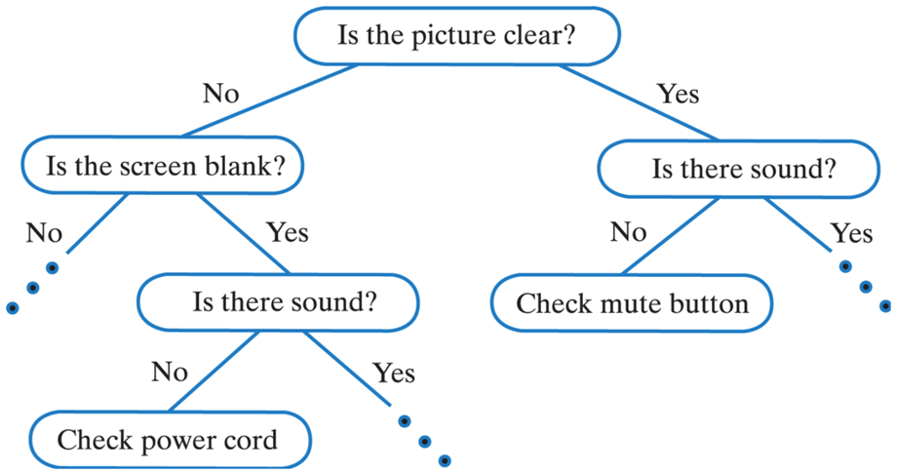
Decision Tree
Binary tree associated with a decision process
internal nodes: questions with yes/no answer
external nodes: decisions

Slide 11
Inorder Traversal
In an inorder traversal a node is visited after its left subtree and before its right subtree
4
A
Algorithm inOrder(v)
if hasLeft (v)
inOrder (left (v));
visit(v);
if hasRight (v)
inOrder (right (v));
2
6
B
C
1
3
8
5
D
E
F
D, B, E, A, F, C

Slide 12
Print Arithmetic Expressions
Specialization of an inorder traversal
print operand or operator when visiting node
print “(“ before traversing left subtree
print “)“ after traversing right subtree
Algorithm printExpression(v)
if hasLeft (v) print(“(’’);
inOrder (left(v));
print(v.element ());
if hasRight (v)
inOrder (right(v));
print (“)’’);
+
×
×
2
−
3
b
((2 × (a − 1)) + (3 × b))
a
1

Slide 13
Balanced binary tree
A binary tree is balanced if for every internal node v of T, the heights of the children of v can differ by at most 1.
Note: the height of a balanced binary tree is O(log n)
3
3
A
A
2
0
2
1
B
C
B
C
1
0
1
0
0
0
D
E
D
E
F
G
0
0
0
F
G
H
Unbalanced
Balanced

Slide 14
Linked Structure for Binary Trees
∅
A node is represented by an object storing
Element
Parent node
Left child node
Right child node
Node objects implement the Position ADT
B
∅
∅
A
D
B
A
∅
∅
∅
∅
D
C
E
C
E

Slide 15
Array-Based Representation of Binary Trees
nodes are stored in an array
1
A
…
2
3
B
D
let rank(node) be defined as follows:
rank(root) = 1
if node is the left child of parent(node), rank(node) = 2*rank(parent(node))
if node is the right child of parent(node), rank(node) = 2*rank(parent(node))+1
4
5
6
7
E
F
C
J
10
11
G
H

